Slide 1

Target Markets for a Business

Slide 2
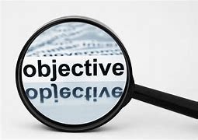
Lesson Objectives
What is Market Segmentation
What is a Target Market
How to Target Market
Why is Target Marketing Important

Slide 3
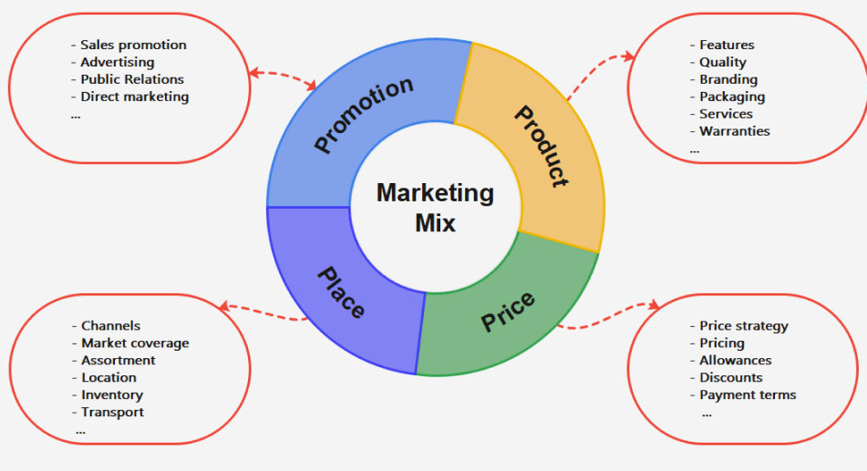
The marketing mix refers to the set of actions, or tactics, that a company uses to promote its brand or product in the market to those customers most likely to buy your product
Strategies
  The 4ps of Marketing Defined:
  Product - How you will design and create your product
  Price – what you will sell it for
  Promote - where and how you tell customers about it
  Place – Locations where you will sell it at
Sell on line, in store, download
Location
How to ship it

Slide 4
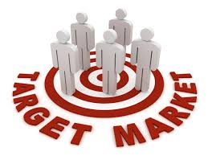
Businesses Aim their Marketing Mix at their Customers
Will Everyone in the World buy your product?
Just like aiming for a bullseye in a game, businesses aim their products at specific groups of people
These customers are known as your Target Market

Slide 5
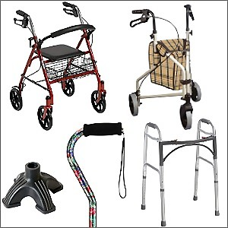
Who Buys this?
First thing to pop in your mind?
Who?
Old People
Be more specific, what type of old people?
Elderly MEN & WOMEN
Why do they buy it?
Mobility issues
Independence – still walk
Safety – they don’t fall
How much does it cost?
Some inexpensive, some not

Slide 6
Will Others Besides old People Buy it?
Yes – brainstorm at your table, see if you can come up with 3 more answers
Put these on your white boards – we will share

Slide 7
Others to Buy it
Elderly MEN & WOMEN
Other People That Buy:
Disabled Individuals
Health Care Providers
Individuals recovering after Surgery
Veterans
Children with Disabilities

Slide 8
Common Characteristics of those that buy it?
  Men & Women age 65 or older
  Individuals with disabilities or recovering from surgeries
  Lower to upper income levels
  Need Assistance to walk
  Have Mobility issues
  Want Independence – they want to walk
  Want Safety – Be safe while walking

Slide 9
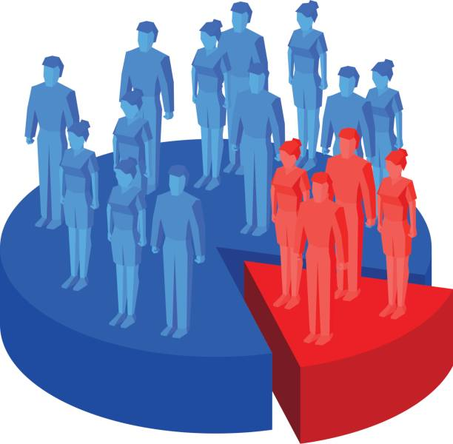
Market: All the people who buy products
In the United States = 340 Million People
Will 340 million buy my product?
  no
  I must find the people that will buy it and target all my marketing efforts (product, place, price, promotion) toward who will buy it
Market segmentation: when you narrow the whole market down through common buying characteristics to focus on a piece of the market
When you Identify the smaller pieces, you focus your Marketing Efforts towards:
  Product - How you will design and create product
  Price – what you will sell it for
  Promote - where and how you tell customers about it
  Place – Where you will sell it

Slide 10
What is a Target Market?
Target Market: smaller more specific groups of consumers with common characteristics that make them more likely to be interested and to buy your product
- The pieces of the market (pie) that you will focus on

Slide 11
Table Talk:
On White Boards answer questions
Will you Promote this through a TV commercial and play it on ever TV station, at every hour of the day?
No Return on your Investment (ROI) for the cost of the TV Commercial
Where would you try to promote?
Would you sell it in every store, in every city?
No, as elderly men and women don’t shop everywhere to get these devices
Where could you Place (sell) it?
Online ads, social media pages, magazines, with doctors, in medical stores, assisted living communities
Walmart, Target, online retailers like Amazon, in hospitals, doctor’s offices, Medical stores

Slide 12
1. Product: Walking Devices
Variety: Offer a range of walking devices including canes, walkers, rollators, and knee scooters to cater to different mobility needs.
Quality: Durable, lightweight materials for ease of use and longevity.
Design: Ergonomic design for comfort and stability; adjustable height and handles.
2. Pricing Strategy:
Competitive Pricing: Align with industry standards to remain competitive.
Discounts and Offers: Seasonal discounts, bulk purchase discounts for healthcare providers, loyalty programs for repeat customers.
Financing Options: Installment plans or financing options for high-end models.
3. Place: Distribution Channels:
Online: E-commerce websites (company’s own site, Amazon, medical supply stores)
Retail: Pharmacies and drugstores, Medical supply stores, Large retail chains like Walmart or Target
Healthcare Providers: Hospitals and clinics, Physiotherapy and rehabilitation centers
Community Centers: Senior centers, community health fairs, and wellness workshops.
4. Promotion:
Marketing Strategies: Educational Content: Informative blog posts, videos, and webinars on the benefits/and proper use
Healthcare Professional Endorsements: Partner with doctors, physiotherapists, and occupational therapists
Advertising: Online ads and print ads targeting the elderly and their caregivers on social media platforms, Google Ads in magazines and newspapers targeting senior citizens.
Events and Sponsorships: Sponsor health fairs, community events, and senior wellness programs.
Sales Promotions: Limited-time discounts, special offers during health awareness months.
Public Relations: Press releases and media coverage on product launches. Customer reviews and ratings to build trust and credibility.

Slide 13

Quick Write
In your activity Packet Answer in your own words why do you think that Market Segmentation to find your Target Market is important to businesses?
Google Classroom Assignment 5-2 Target Market Review

